Slide 1
Artificial Intelligence
Knowledge Representation
Iftekhar Mahmud Towhid

Slide 2
Representation
AI agents deal with knowledge (data)
  Facts (believe & observe knowledge)
  Procedures (how to knowledge)
  Meaning (relate & define knowledge)
Right representation is crucial
  Early realisation in AI
  Wrong choice can lead to project failure
  Active research area

Slide 3
Choosing a Representation
For certain problem solving techniques
  ‘Best’ representation already known
  Often a requirement of the technique
  Or a requirement of the programming language (e.g. Prolog)
Examples
  First order theorem proving… first order logic
  Inductive logic programming… logic programs
  Neural networks learning… neural networks
Some general representation schemes
  Suitable for many different (and new) AI applications

Slide 4
Some General Representations
Logical Representations
Production Rules
Semantic Networks
  Conceptual graphs, frames
Description Logics (see textbook)

Slide 5
What is a Logic?
A language with concrete rules
  No ambiguity in representation (may be other errors!)
  Allows unambiguous communication and processing
  Very unlike natural languages e.g. English
Many ways to translate between languages
  A statement can be represented in different logics
  And perhaps differently in same logic
Expressiveness of a logic
  How much can we say in this language?
Not to be confused with logical reasoning
  Logics are languages, reasoning is a process (may use logic)

Slide 6
Syntax and Semantics
Syntax
  Rules for constructing legal sentences in the logic
  Which symbols we can use (English: letters, punctuation)
  How we are allowed to combine symbols
Semantics
  How we interpret (read) sentences in the logic
  Assigns a meaning to each sentence
Example: “All lecturers are seven foot tall”
  A valid sentence (syntax)
  And we can understand the meaning (semantics)
  This sentence happens to be false (there is a counterexample)

Slide 7

Propositional Logic
Syntax
  Propositions, e.g. “it is wet”
  Connectives: and, or, not, implies, iff (equivalent)
  Brackets, T (true) and F (false)
Semantics (Classical AKA Boolean)
  Define how connectives affect truth
    “P and Q” is true if and only if P is true and Q is true
  Use truth tables to work out the truth of statements

Slide 8
Predicate Logic
Propositional logic combines atoms
  An atom contains no propositional connectives
  Have no structure (today_is_wet, john_likes_apples)
Predicates allow us to talk about objects
  Properties: is_wet(today)
  Relations: likes(john, apples)
  True or false
In predicate logic each atom is a predicate
  e.g. first order logic, higher-order logic

Slide 9
First Order Logic
More expressive logic than propositional
  Used in this course (Lecture 6 on representation in FOL)
Constants are objects: john, apples
Predicates are properties and relations:
  likes(john, apples)
Functions transform objects:
  likes(john, fruit_of(apple_tree))
Variables represent any object: likes(X, apples)
Quantifiers qualify values of variables
  True for all objects (Universal): ∀X. likes(X, apples)
  Exists at least one object (Existential): ∃X. likes(X, apples)

Slide 10
Example: FOL Sentence
“Every rose has a thorn”
For all X
  if (X is a rose)
  then there exists Y
    (X has Y) and (Y is a thorn)

Slide 11
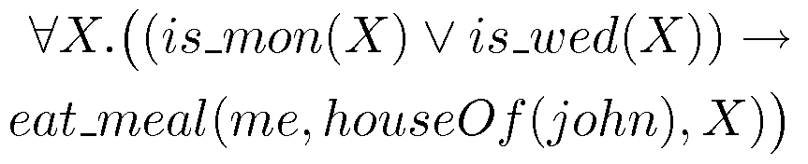
Example: FOL Sentence
“On Mondays and Wednesdays I go to John’s house for dinner”
Note the change from “and” to “or”
  Translating is problematic

Slide 12

Higher Order Logic
More expressive than first order
Functions and predicates are also objects
  Described by predicates: binary(addition)
  Transformed by functions: differentiate(square)
  Can quantify over both
E.g. define red functions as having zero at 17
Much harder to reason with

Slide 13
Beyond True and False
Multi-valued logics
  More than two truth values
  e.g., true, false & unknown
  Fuzzy logic uses probabilities, truth value in [0,1]
Modal logics
  Modal operators define mode for propositions
  Epistemic logics (belief)
    e.g. p (necessarily p), p (possibly p), …
  Temporal logics (time)
    e.g. p (always p), p (eventually p), …

Slide 14
Logic is a Good Representation
Fairly easy to do the translation when possible
Branches of mathematics devoted to it
It enables us to do logical reasoning
  Tools and techniques come for free
Basis for programming languages
  Prolog uses logic programs (a subset of FOL)
  λProlog based on HOL

Slide 15
Non-Logical Representations?
Production rules
Semantic networks
  Conceptual graphs
  Frames
Logic representations have restricitions and can be hard to work with
  Many AI researchers searched for better representations

Slide 16
Production Rules
Rule set of <condition,action> pairs
  “if condition then action”
Match-resolve-act cycle
  Match: Agent checks if each rule’s condition holds
  Resolve:
    Multiple production rules may fire at once (conflict set)
    Agent must choose rule from set (conflict resolution)
  Act: If so, rule “fires” and the action is carried out
Working memory:
  rule can write knowledge to working memory
  knowledge may match and fire other rules

Slide 17
Production Rules Example
IF (at bus stop AND bus arrives) THEN action(get on the bus)
IF (on bus AND not paid AND have oyster card) THEN action(pay with oyster) AND add(paid)
IF (on bus AND paid AND empty seat) THEN sit down
conditions and actions must be clearly defined
  can easily be expressed in first order logic!

Slide 18
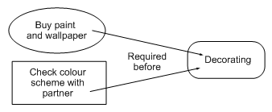

Graphical Representation
Humans draw diagrams all the time, e.g.
  Causal relationships
  And relationships between ideas

Slide 19
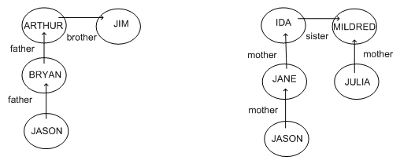
Graphical Representation
Graphs easy to store in a computer
To be of any use must impose a formalism
  Jason is 15, Bryan is 40, Arthur is 70, Jim is 74
  How old is Julia?

Slide 20
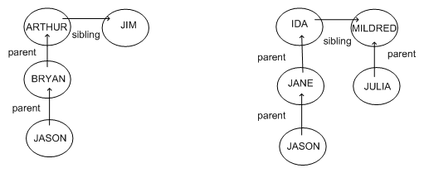
Semantic Networks
Because the syntax is the same
  We can guess that Julia’s age is similar to Bryan’s
Formalism imposes restricted syntax

Slide 21
Semantic Networks
Graphical representation (a graph)
  Links indicate subset, member, relation, ...
Equivalent to logical statements (usually FOL)
  Easier to understand than FOL?
  Specialised SN reasoning algorithms can be faster
Example: natural language understanding
  Sentences with same meaning have same graphs
  e.g. Conceptual Dependency Theory (Schank)

Slide 22
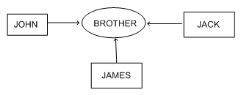
Conceptual Graphs
Semantic network where each graph represents a single proposition
Concept nodes can be
  Concrete (visualisable) such as restaurant, my dog Spot
  Abstract (not easily visualisable) such as anger
Edges do not have labels
  Instead, conceptual relation nodes
  Easy to represent relations between multiple objects

Slide 23
Frame Representations
Semantic networks where nodes have structure
  Frame with a number of slots (age, height, ...)
  Each slot stores specific item of information
When agent faces a new situation
  Slots can be filled in (value may be another frame)
  Filling in may trigger actions
  May trigger retrieval of other frames
Inheritance of properties between frames
  Very similar to objects in OOP

Slide 24
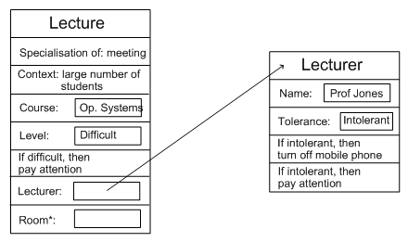
Example: Frame Representation

Slide 25
Flexibility in Frames
Slots in a frame can contain
  Information for choosing a frame in a situation
  Relationships between this and other frames
  Procedures to carry out after various slots filled
  Default information to use where input is missing
  Blank slots: left blank unless required for a task
  Other frames, which gives a hierarchy
Can also be expressed in first order logic

Slide 26
Representation & Logic
AI wanted “non-logical representations”
  Production rules
  Semantic networks
    Conceptual graphs, frames
But all can be expressed in first order logic!
Best of both worlds
  Logical reading ensures representation well-defined
  Representations specialised for applications
  Can make reasoning easier, more intuitive

